Slide 1
NCI update – analyzing CyTOF data
12-6-2024
Ty Bottorff – Bioinformatics postdoc
Linsley lab

Slide 2
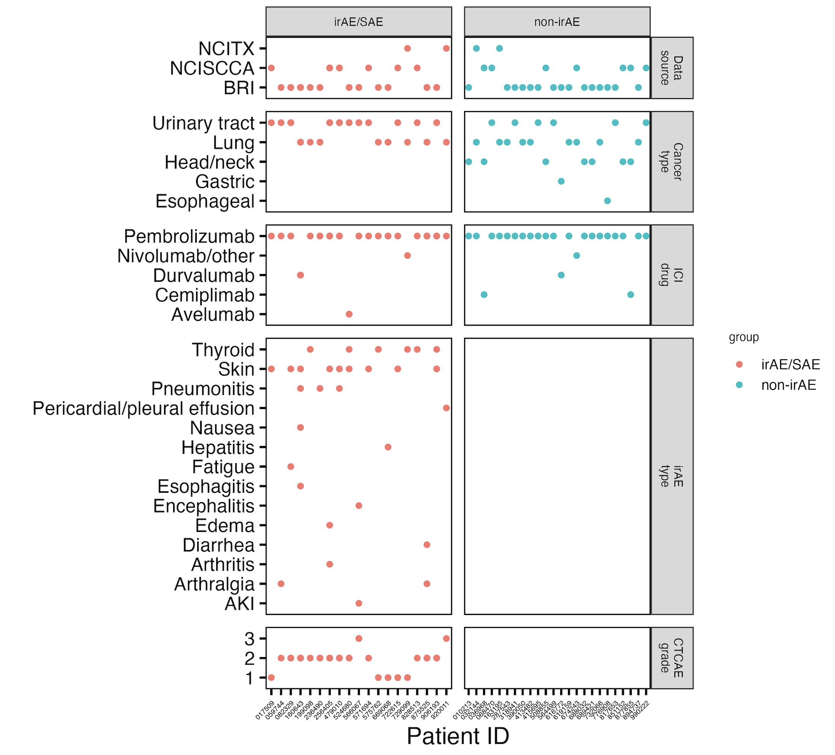
Cancer cohort metadata
Notes:
Ask Jane if grouping arthralgia and arthritis ok here for rheumatoid group (n = 3)

Slide 3
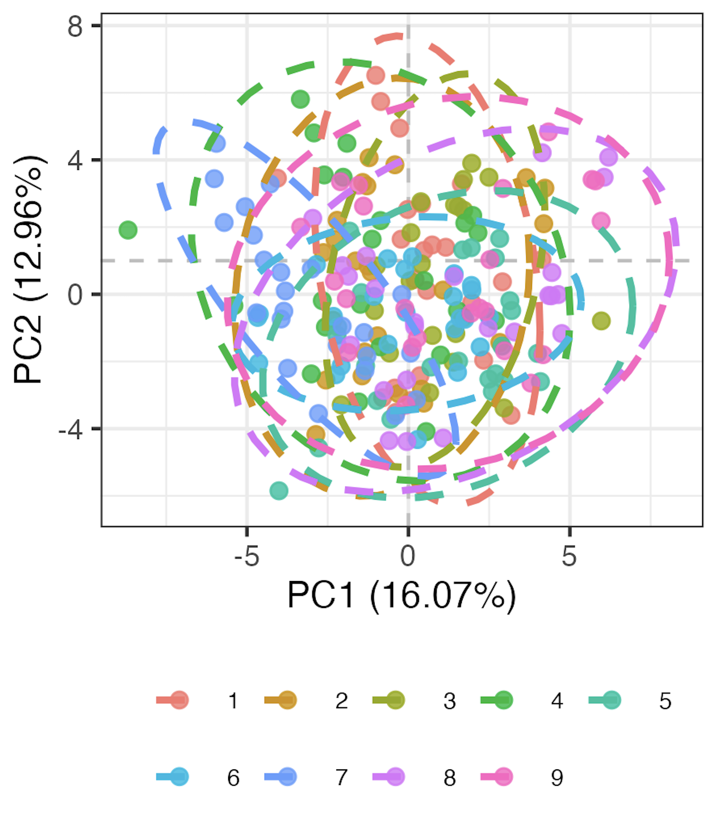
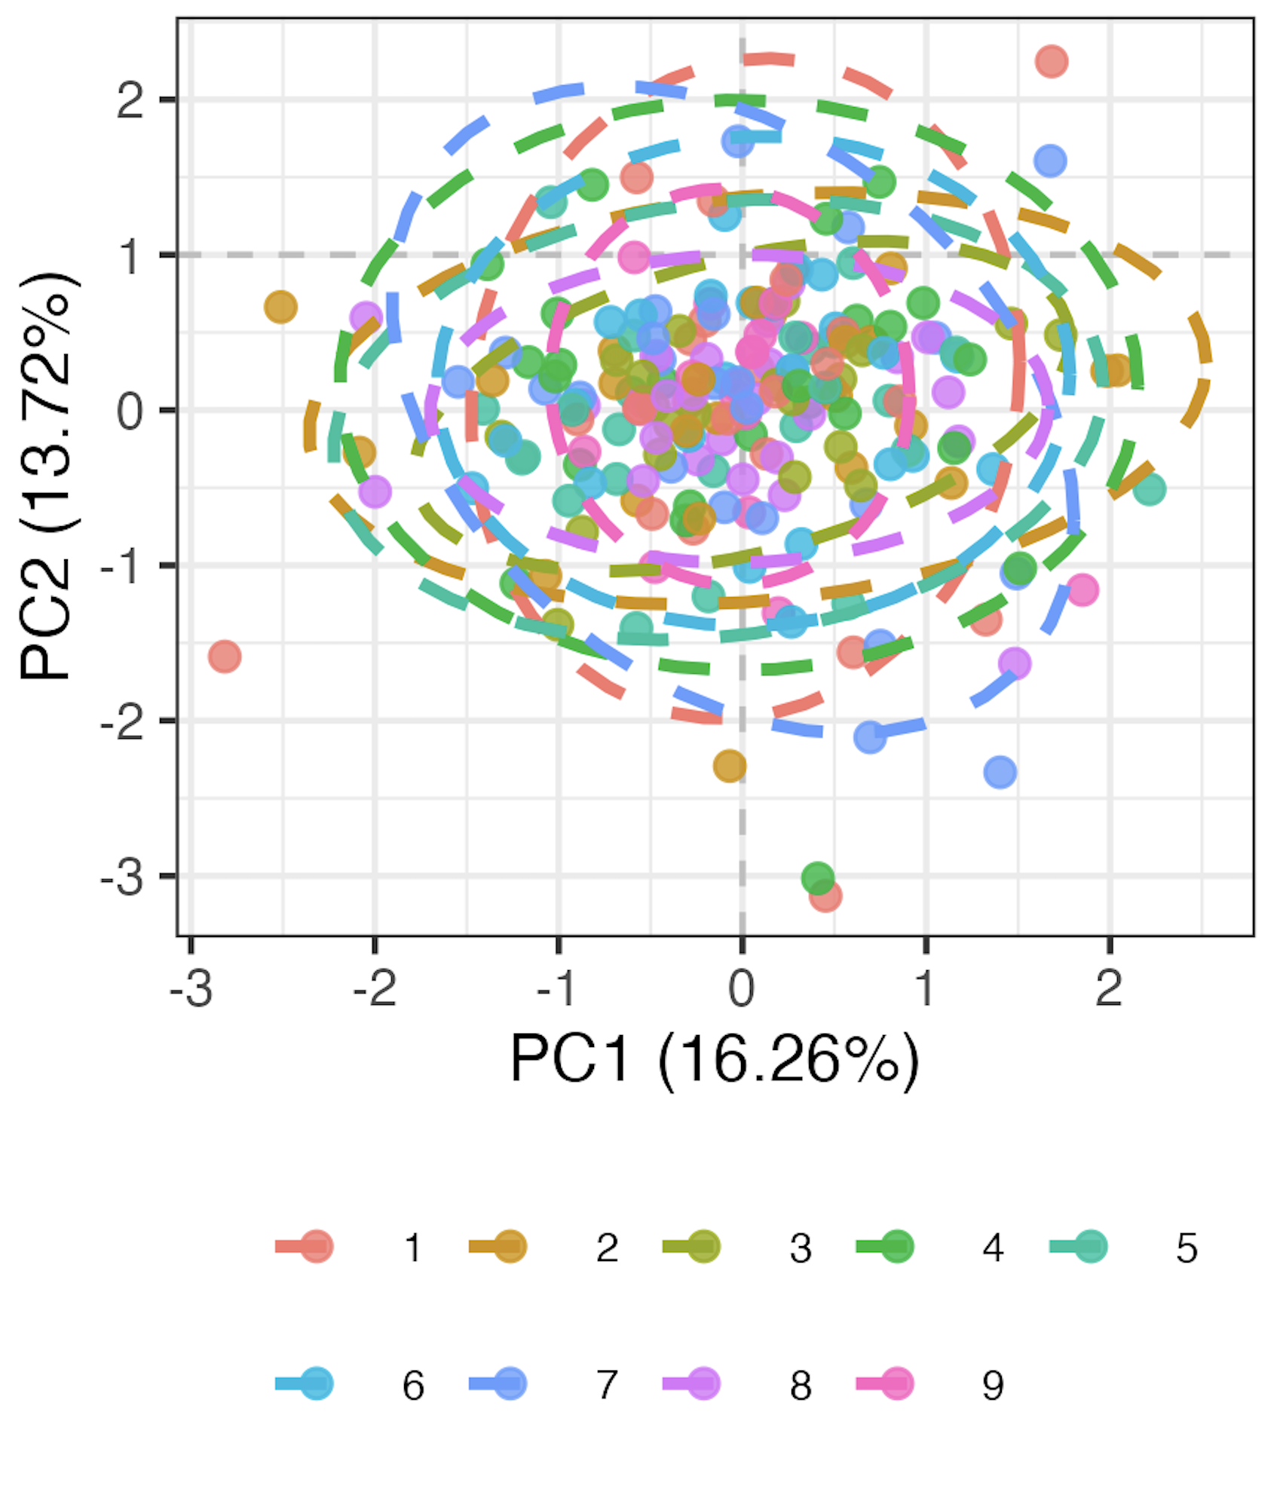
Methods overview
Remove 9 features with high technical variation
Normalize percent of parent data
Logit transform, Z-scale
Run mixed-effects LM for each of 71 remaining features, take residuals as batch-corrected data
Pre
Post
model <- lmer(freq ~ batch + (1|patient_id))
Batch
Batch
Notes:
Logit transforms 0-1 to –inf, inf to normalize data
This is likely overcorrecting but no better idea (yet)

Slide 4
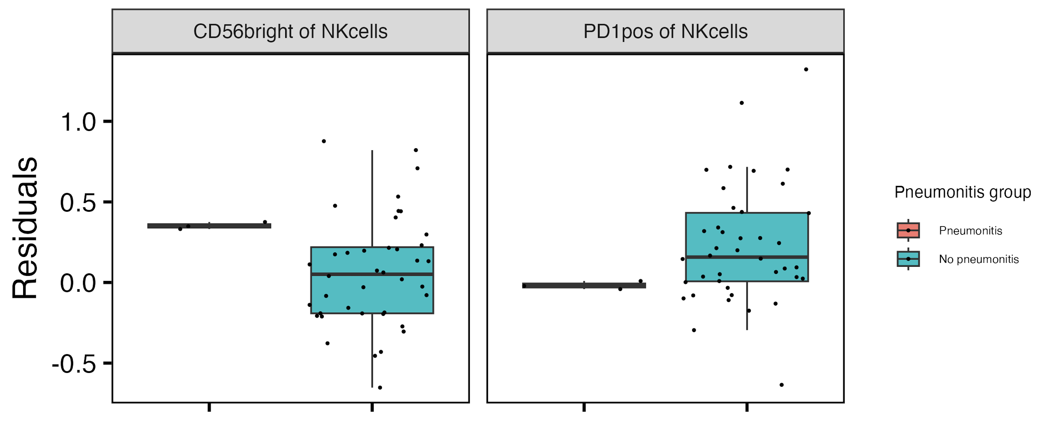
Baseline CD56^{bright} of NK cells frequency higher, PD1⁺ of NK cells frequency lower in those developing pneumonitis
**
**
**: padj < 0.01
Notes:
if including pleural effusion, then PD1+ of NKs drops (padj > 0.05) but it doesn’t matter for CD56bright of NKs
CD56bright NK are abundant cytokine producers but only weakly cytotoxic before activation, PD1+ NK presumably more inhibited…, so these trends make sense with more active → more irAE and more inhibited → less irAE

Slide 5
Baseline feature module methods
For each irAE group comparison
for each feature, test for difference in baseline frequency distributions between irAE groups
arrange by pval
take top 4 features as top feature module
PCA only using features in the module
Notes:
For features with < 5% NAs, replace NAs with mean
this is ~overfitting… so good to raise that caveat. Weak immunotype signals that ”necessitated” this for most irAE group comparisons (except pneumonitis) at baseline
Should also emphasize that modules are somewhat arbitrary in sense that multiple different configurations of mostly same features would likely work for each module approach taken here

Slide 6
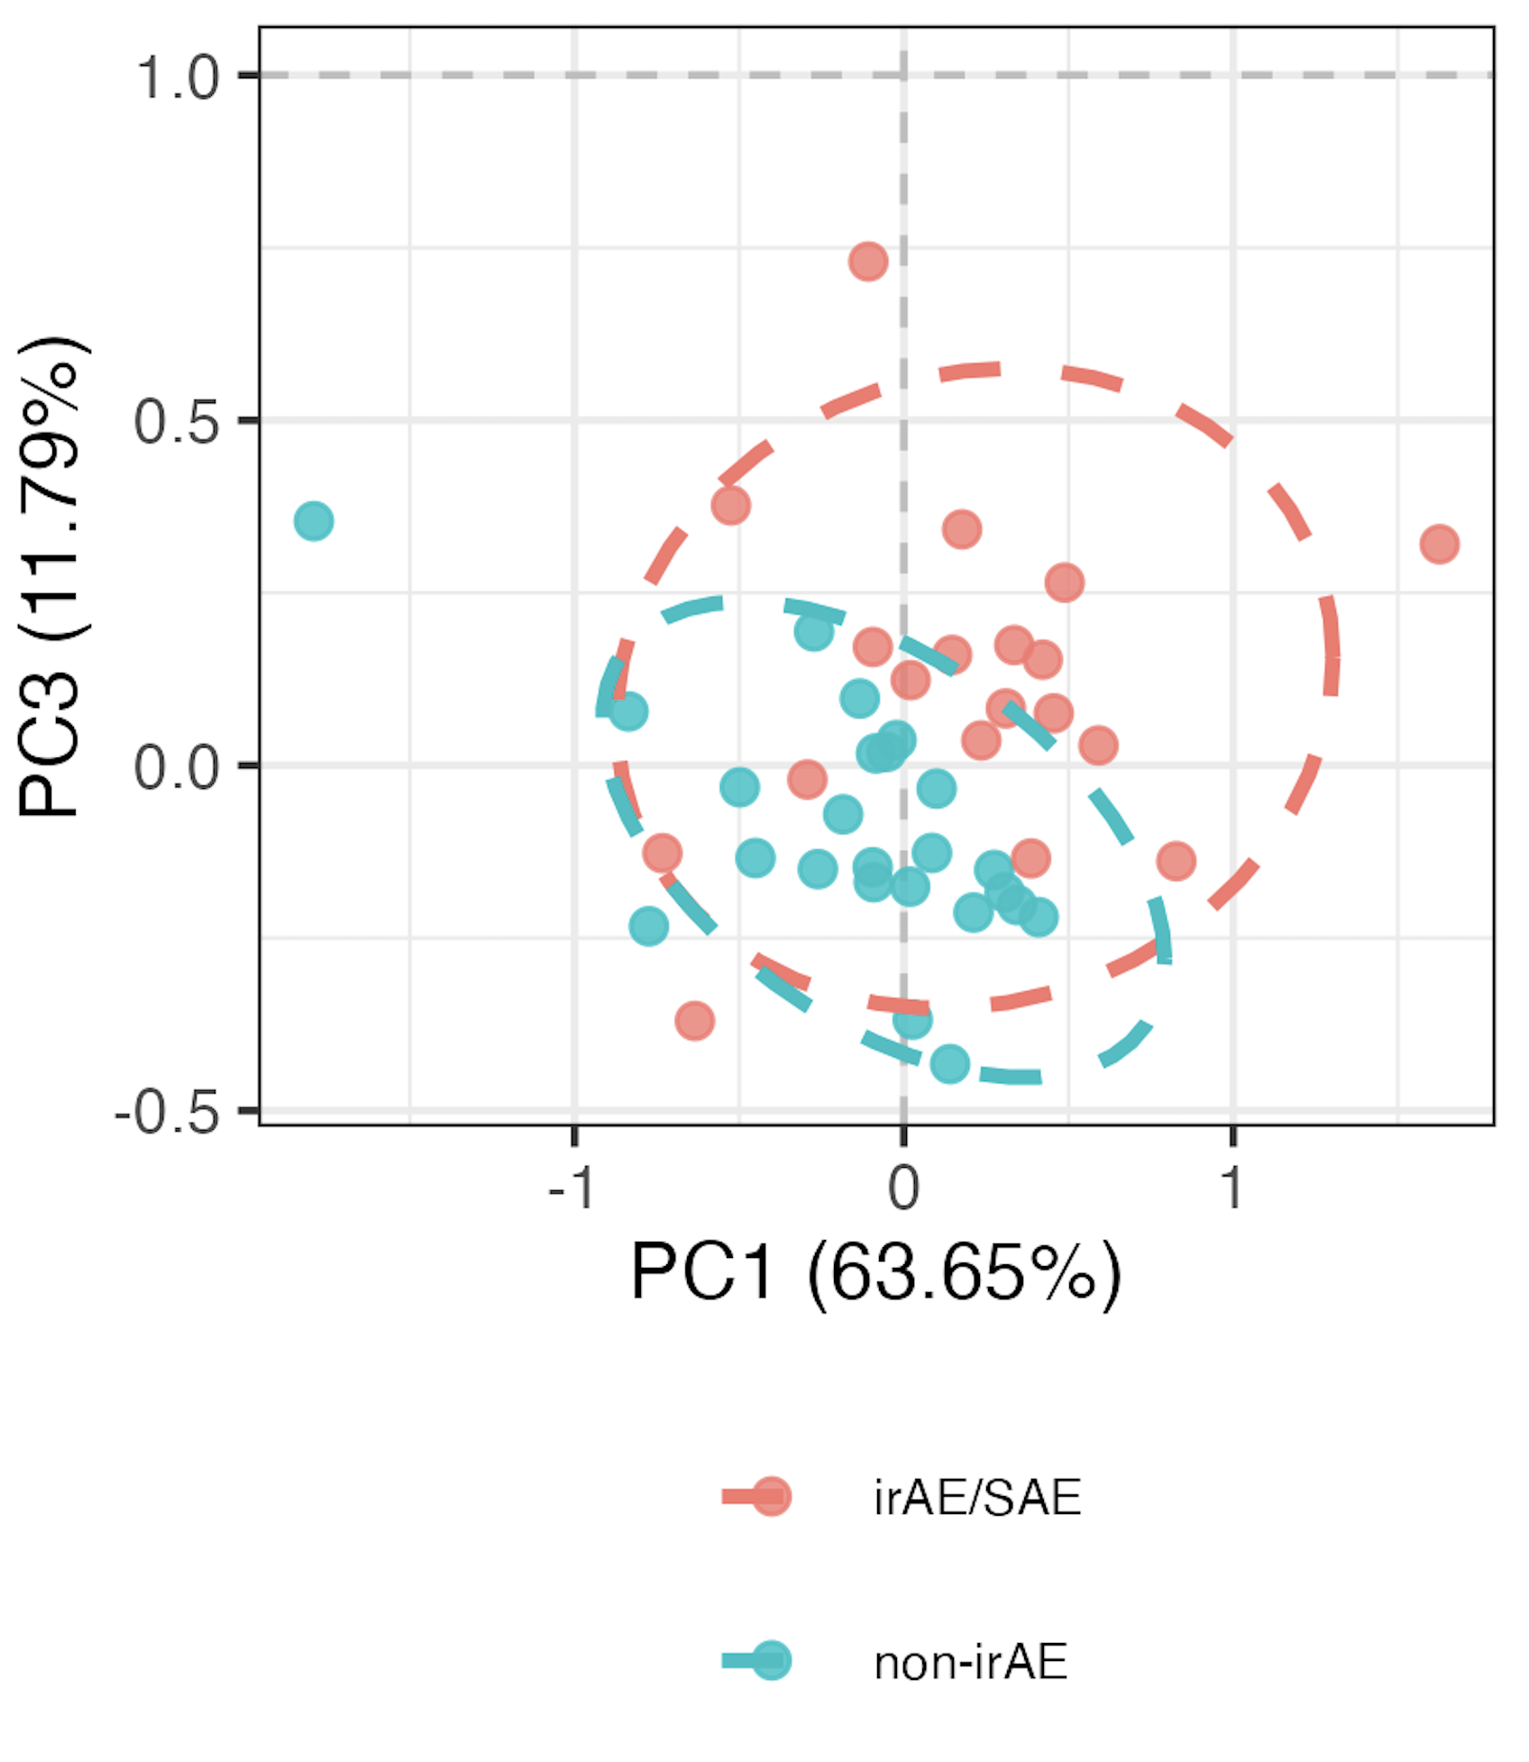
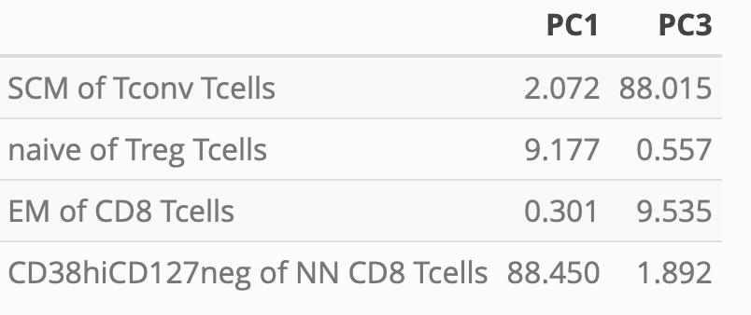
Distinguishing combined irAE group using module of top 4 combined irAE baseline features
PC1/3 contributions
PC1 *
PC3 **
**: p < 0.01, *: p < 0.05

Slide 7
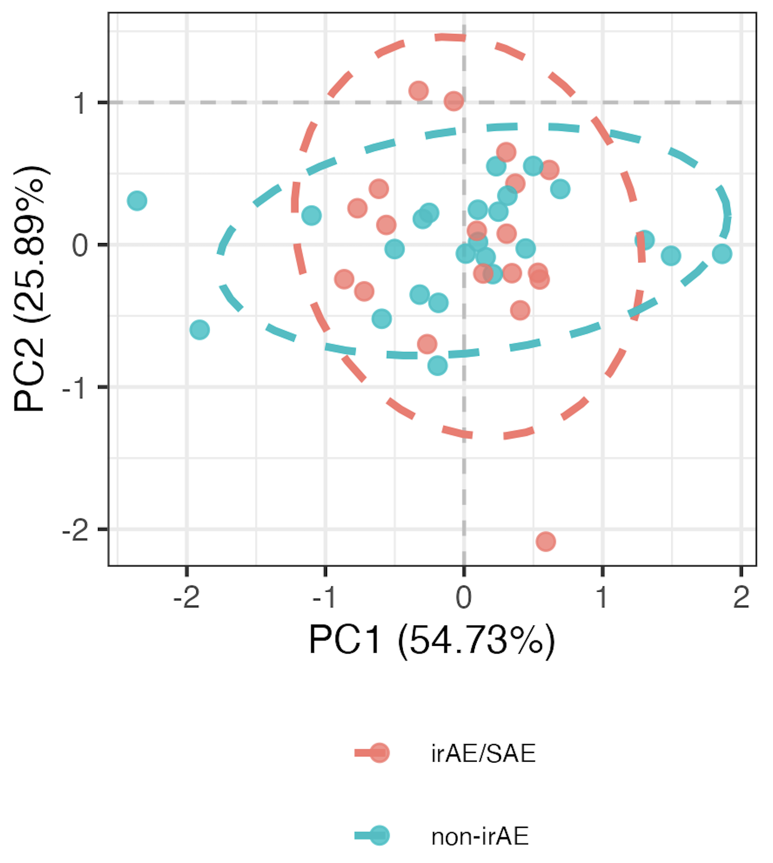
Using randomly formed modules instead
- choosing random set of 4 features 1000 times, obtain separation in PCA space (> 2 p < 0.05’s in PCs 1-3) ~1.1% of the time
“bottom” 4 feature
module
Notes:
Pvals > 0.9 here for PCs 1-3
1.1% translates to pval 0.011 (Monte carlo pval)?
SCM feature most common in sets of 4 that hit significance, not surprisingly given it’s a borderline pval itself…
Can modify set size from 3-10 and still see ~1%
Can run random set test much more than 1000 times and still see ~1%

Slide 8
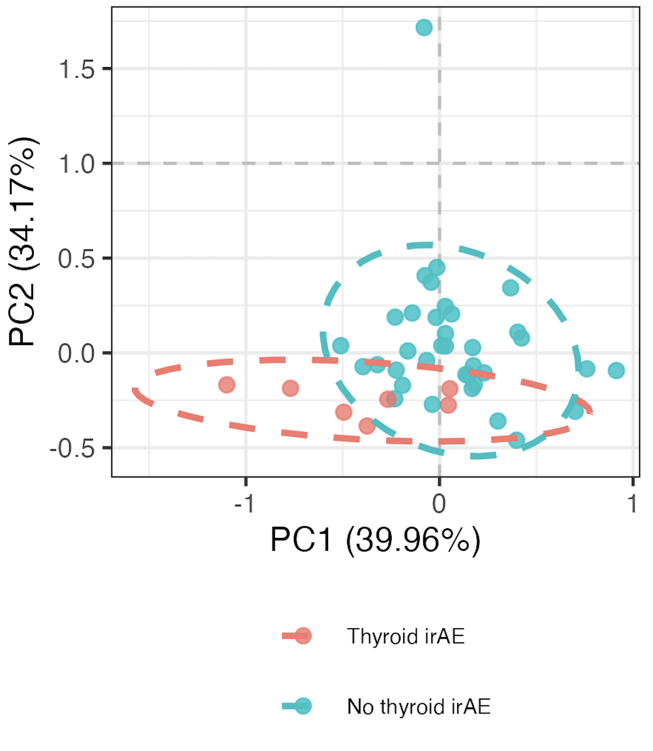
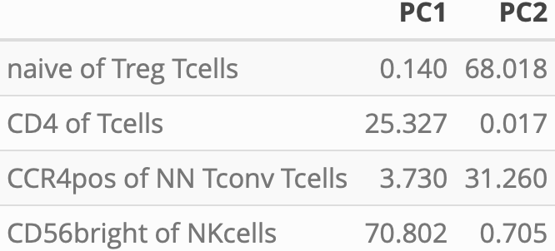
Distinguishing thyroid irAE group using module of top 4 thyroid irAE baseline features
PC1-2 contributions
PC1 *
PC2 **
**: p < 0.01, *: p < 0.05
Notes:
~similar if including OOR in sense that module needed, contributing features are mostly different (CD4 of T cells present both ways)

Slide 9
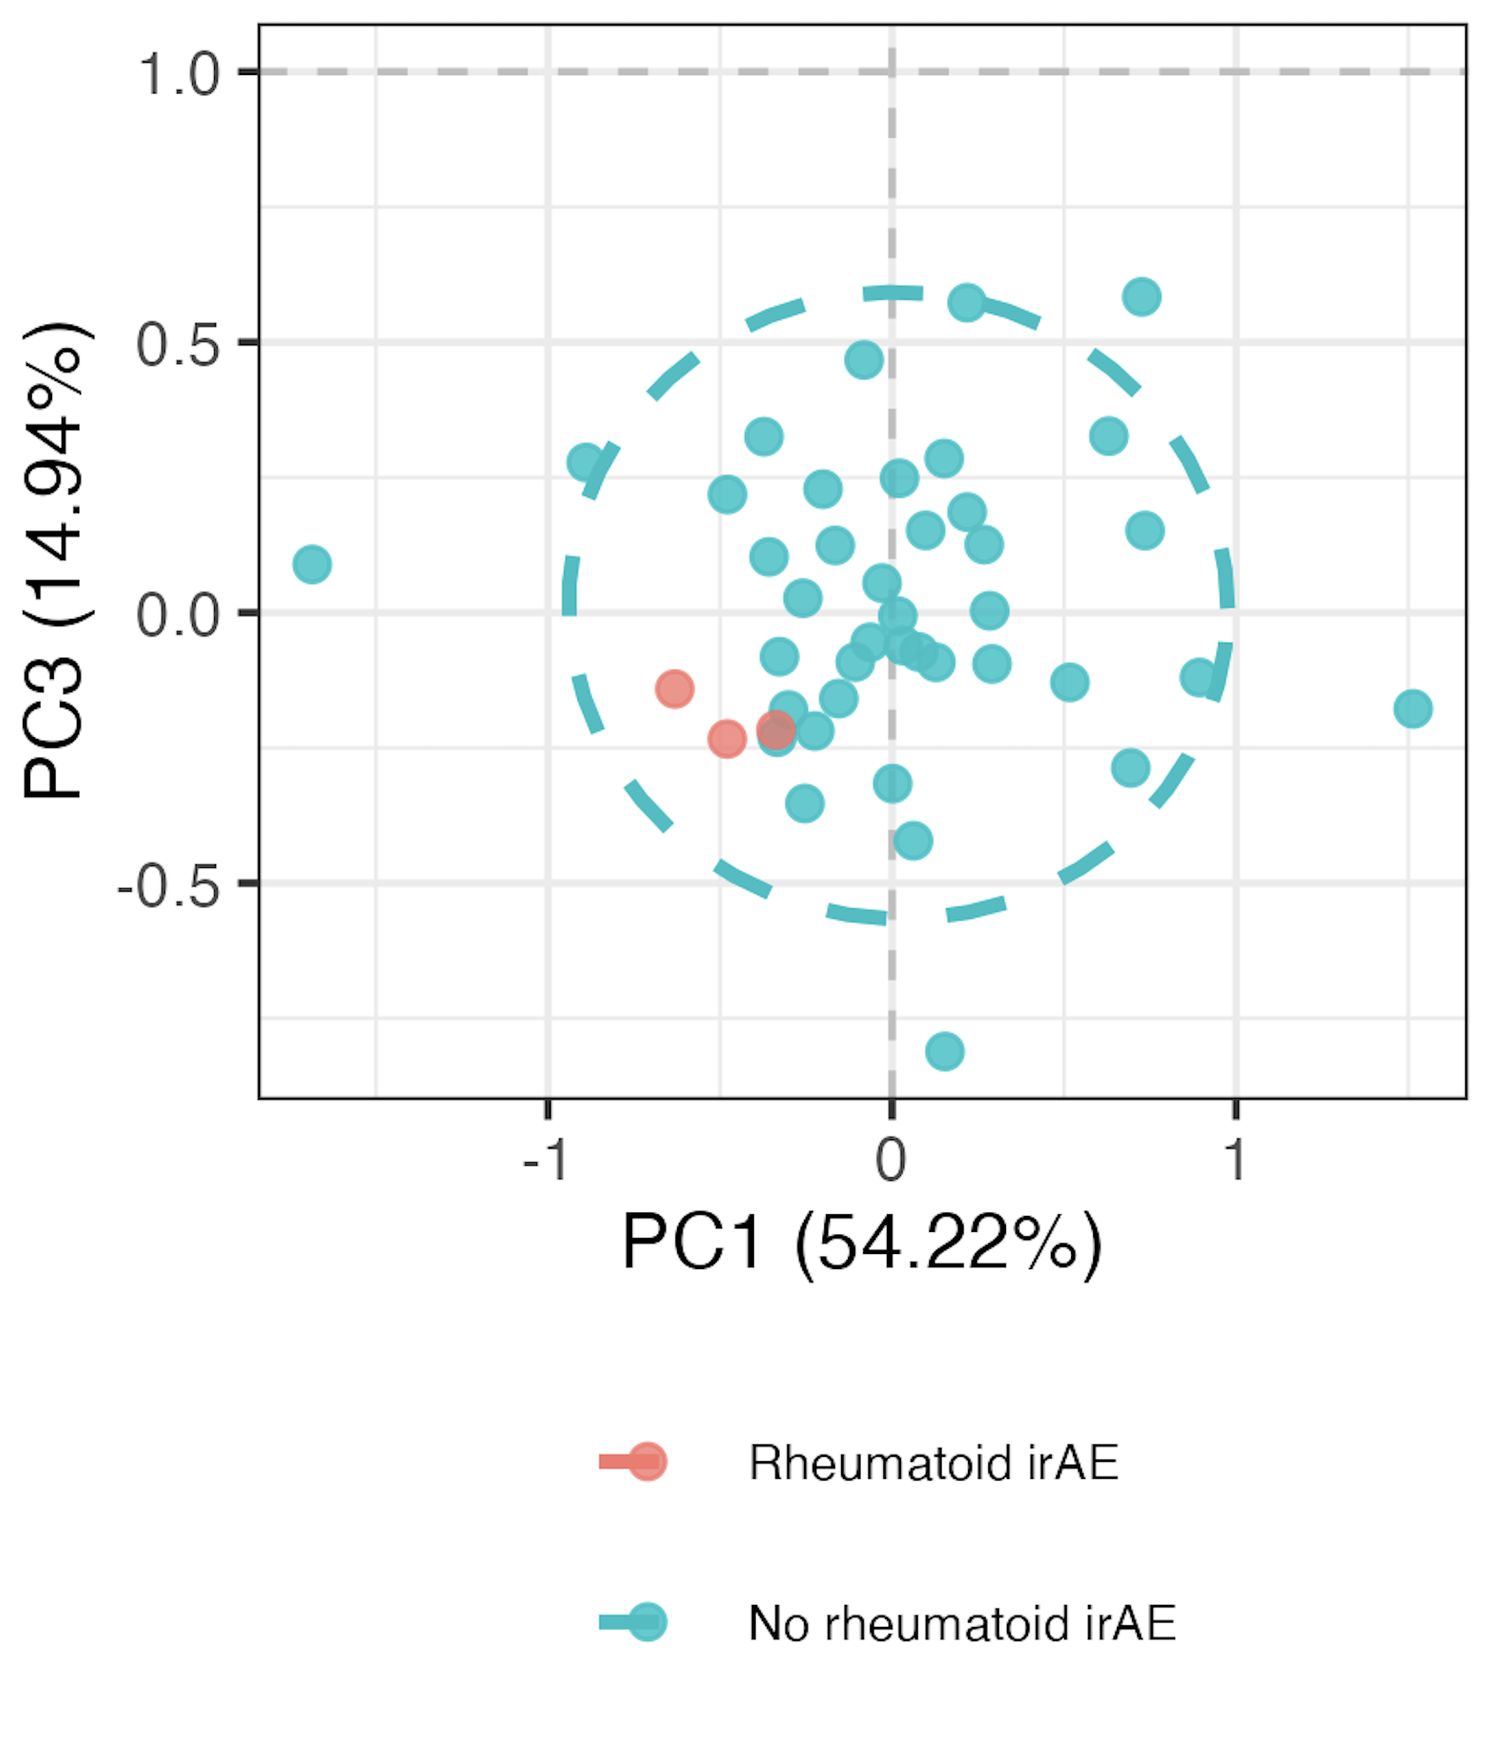
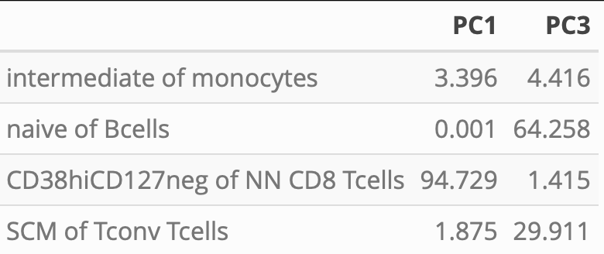
Distinguishing “rheumatoid” irAE group using module of top 4 “rheumatoid” irAE baseline features
PC1/3 contributions
PC1 ** PC3 **
**: p < 0.01, *: p < 0.05
Notes:
Opposite their result, but it was baseline

Slide 10
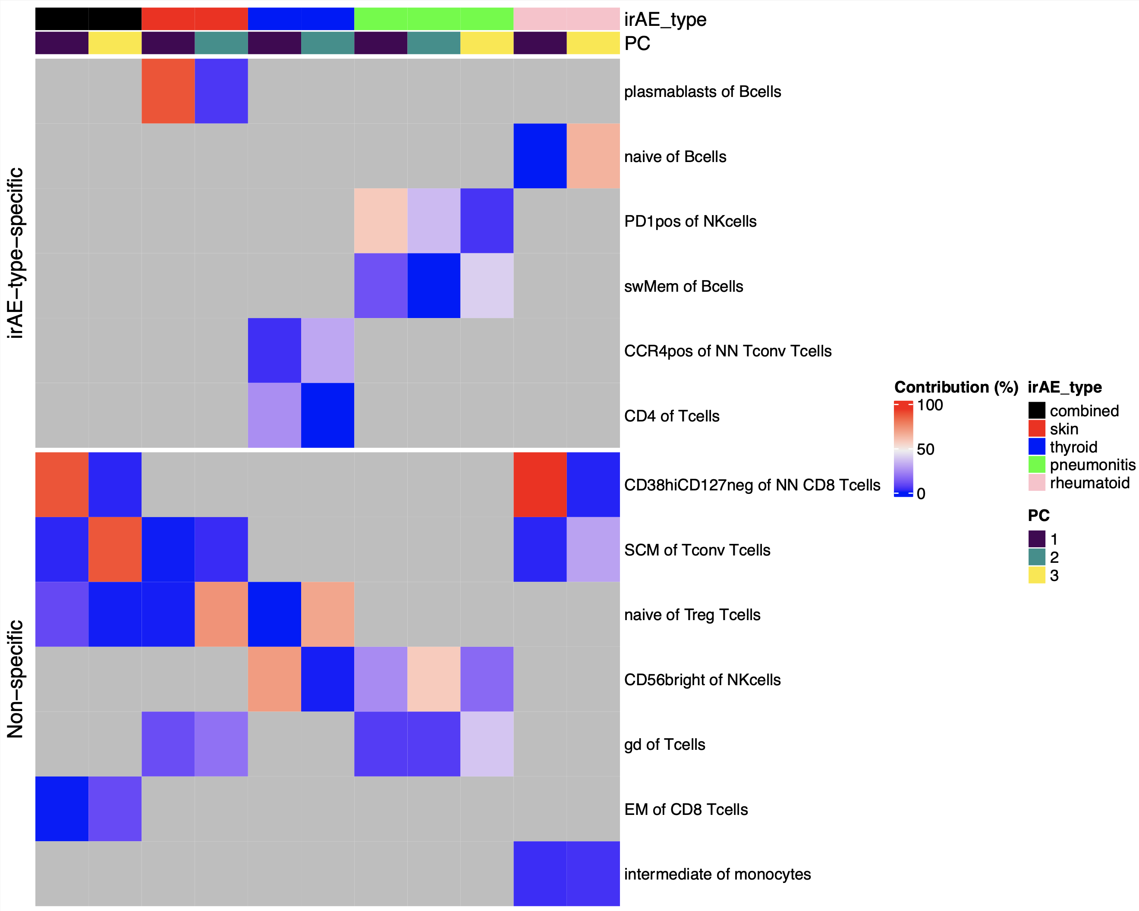
Summary of baseline module analysis: several features may be more irAE-type-specific
reported enriched in ICI-arthritis joints (Wang et al. Sci Immunol., 2023)
reported lower in severe irAE patients at irAE time (Kovacsovics-Bankowski et al. J Immunother Cancer. 2024)
Notes:
Worth raising concern of overfitting to our data (i.e. subsetting features ~arbitrarily), but the non-specific features with literature evidence are perhaps more backed up here (less biased by noise)
Only showing PCs with p < 0.05 for group comparison

Slide 11
Longitudinal analysis methods
Removed PD1⁺ features (15)
Grouped “Visit 2, irAE” and “Visit 3, irAE” with “Visit 2”, “Visit 3”, respectively
Used mixed effect non-linear model with interaction between irAE group & visit, random effect for donor
Looked for significant interactions between irAE group & visit (different slopes from baseline)
model <- gam(freq ~ irae_group * visit + s(patient_id, bs = "re"), data = data, method = 'REML')
Notes:
REML (Restricted Maximum Likelihood) is a statistical technique used for parameter estimation, particularly in mixed-effects models and generalized additive models (GAMs)
If doing irAE time point feature freq comparisons, would take visit 2/3 irAE into irAE group (so differently from here)

Slide 12
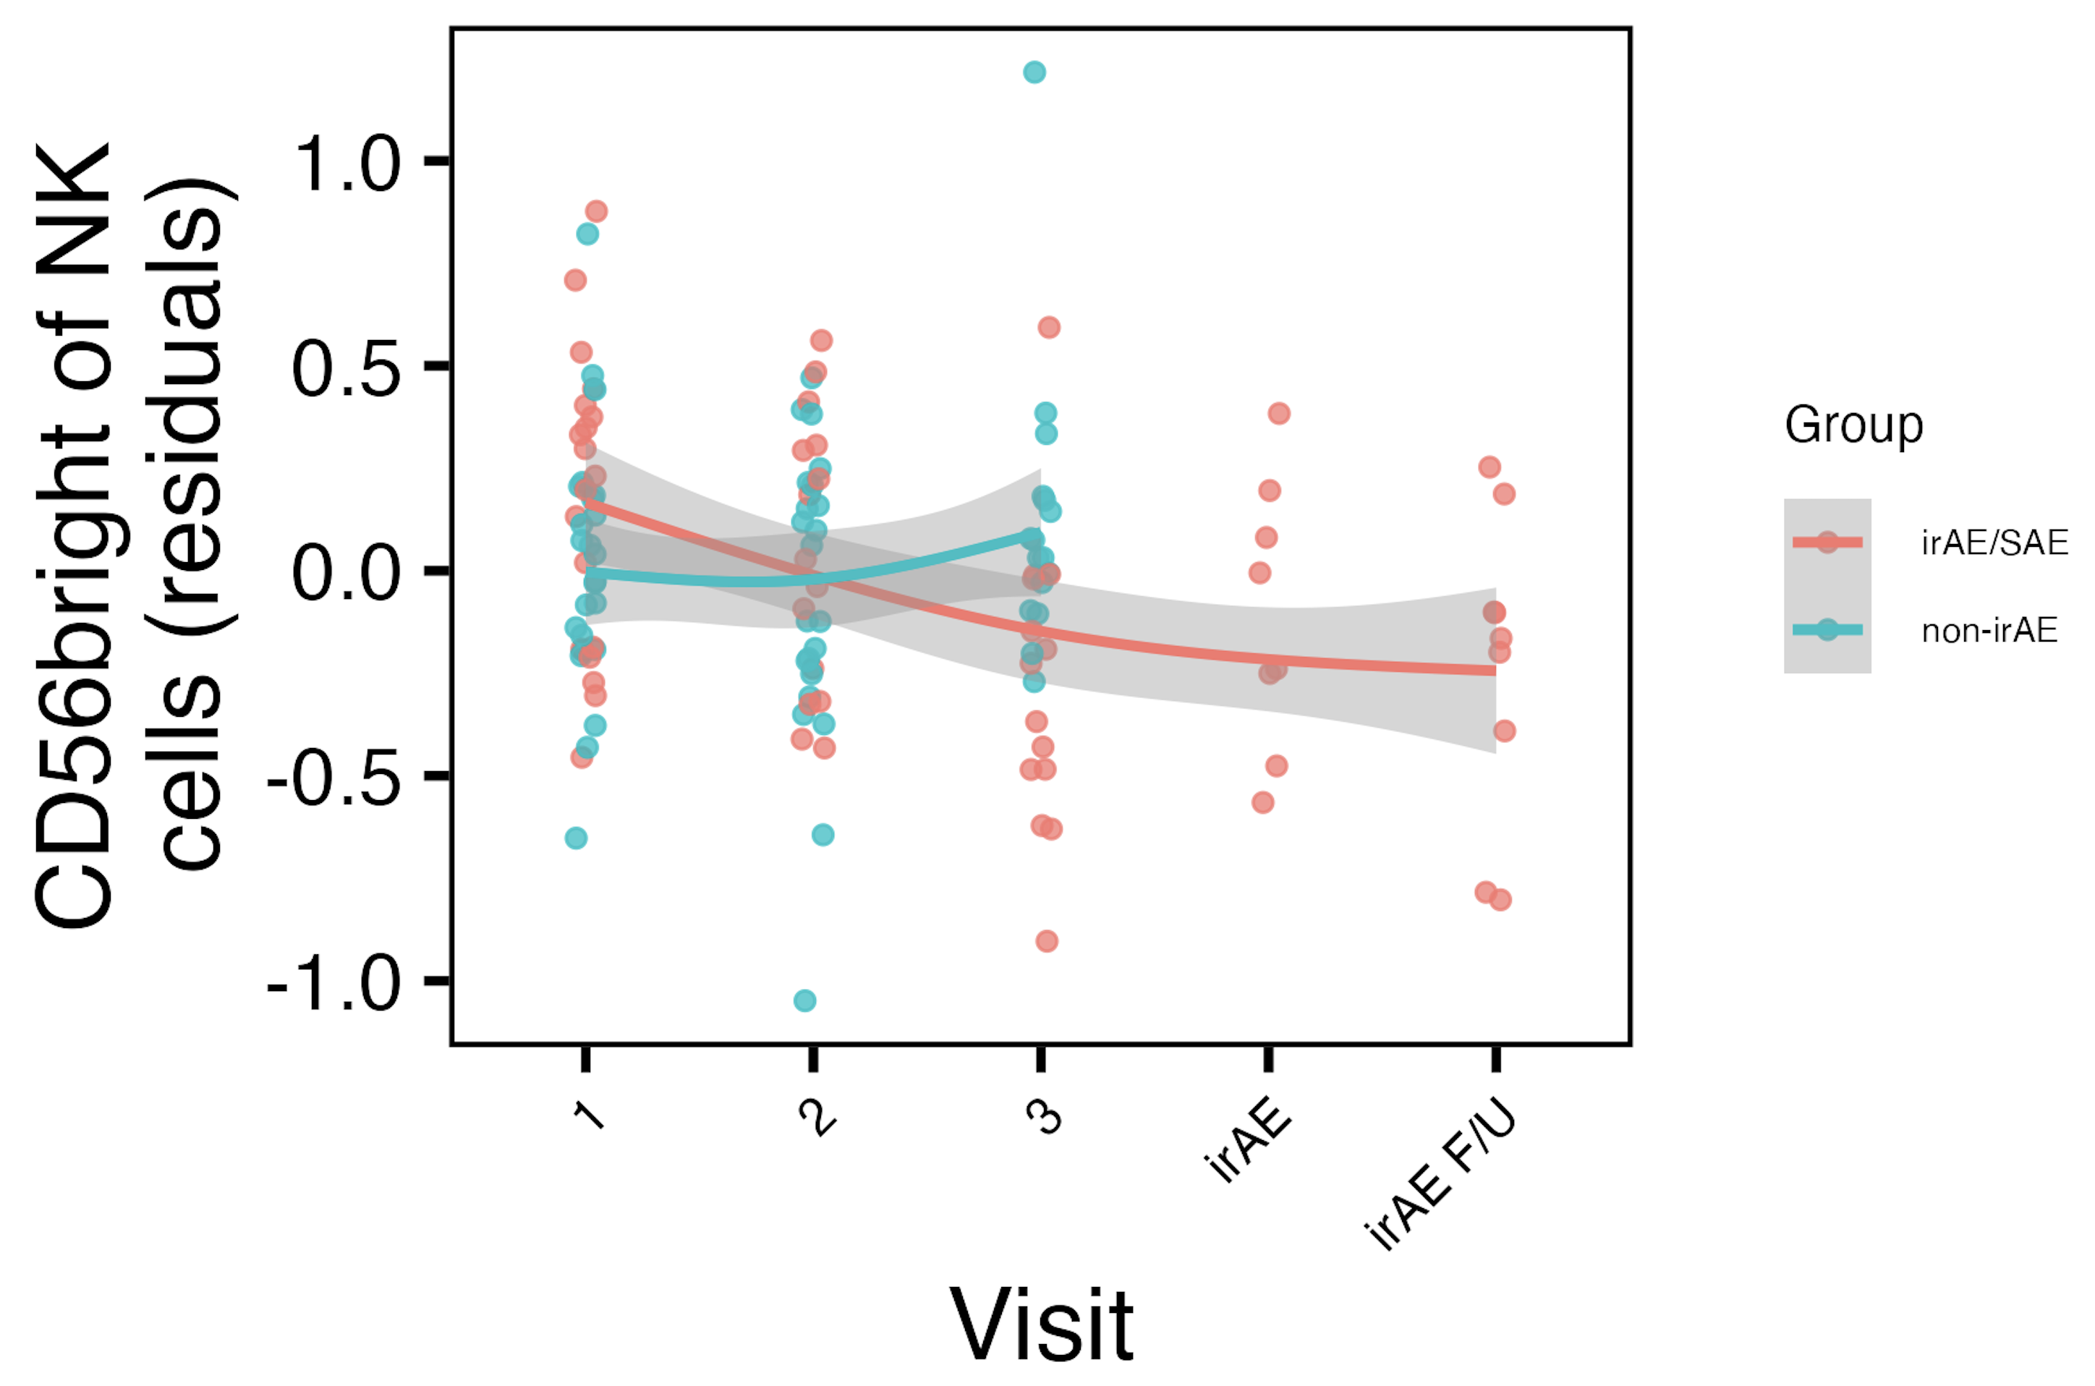
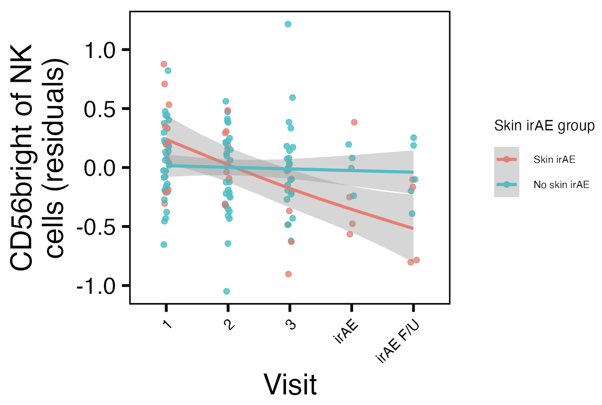
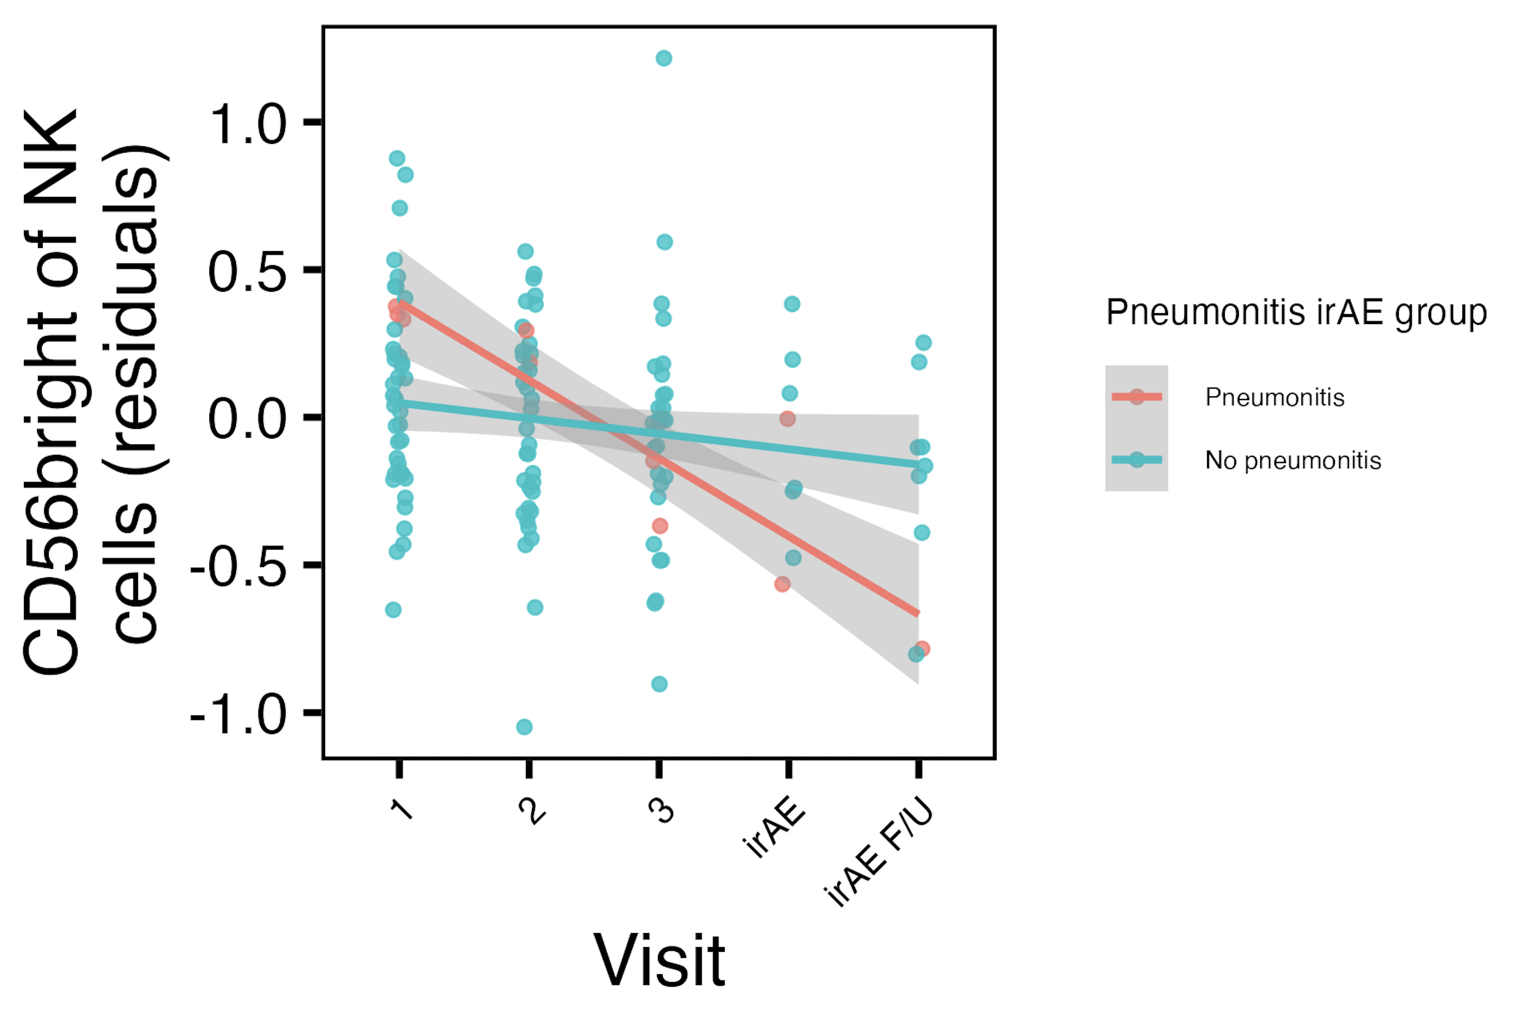
Frequency of CD56^{bright} of NK cells decreases with ICI specifically in combined irAE and skin irAE groups
*
*
CD56^{bright} of NK frequency reported lower in severe irAE patients at irAE time (Kovacsovics-Bankowski et al. J Immunother Cancer. 2024)
*: padj < 0.05
Notes:
See same trend in skin irAE group for CD56bright of NK, and this matches finding from Kovacsovics-Bankowski et al. J Immunother Cancer. 2024 (lower CD56bright of NK in patients at irAE max), surprisingly despite their cohort was mostly not pulmonary irAE and was mostly melanoma!

Slide 13
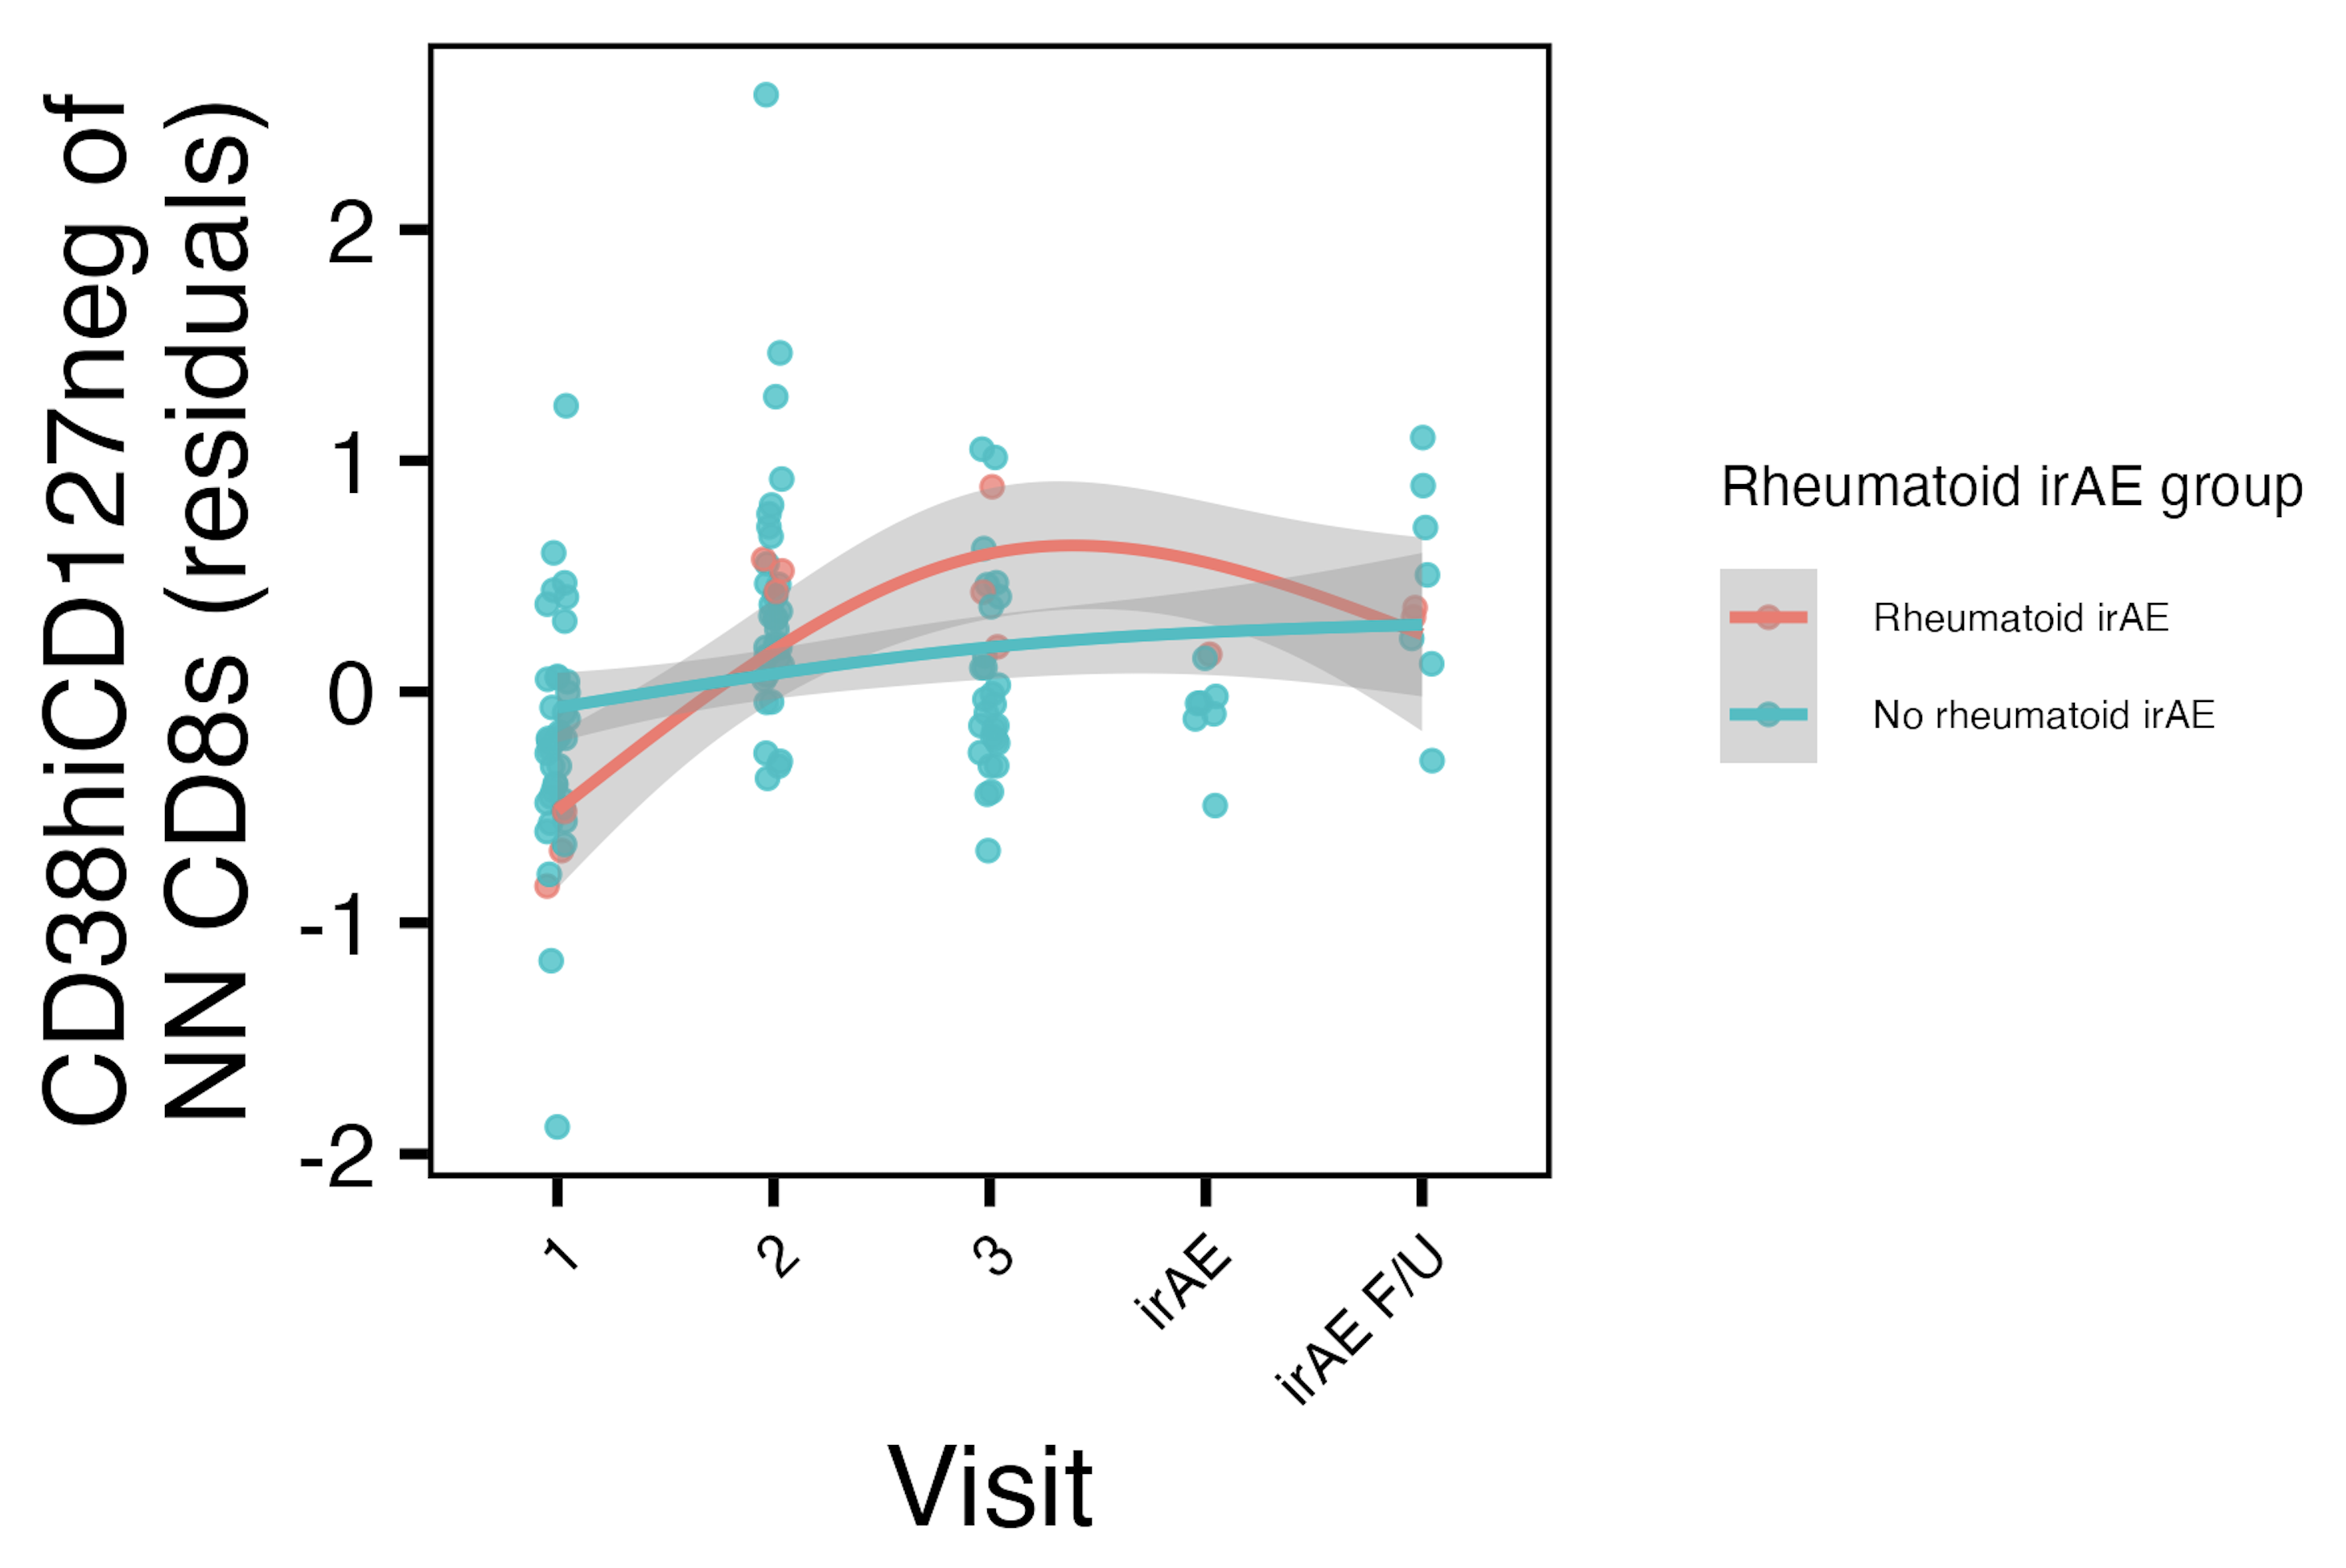
Frequency of CD38^{hi}CD127⁻ of NN CD8s may increase more in “rheumatoid” irAE group
CD38^{hi}CD127⁻ CD8s reported enriched in ICI-arthritis joints (Wang et al. Sci Immunol., 2023)
Notes:
# for rheumatoid, interaction (group-visit3) effects for DN of Tcells (padj = 0.044) and CRTH2+ of NN Tconv Tcells (padj = 0.015)

Slide 14
Conclusions
Baseline analyses
CD56^{bright} of NK cells frequency higher, PD1⁺ of NK cells frequency lower in those developing pneumonitis
some features may appear more irAE-type specific
can use module of features to identify immunotypes of combined irAE, thyroid irAEs, skin, “rheumatoid” irAEs
Longitudinal analyses: some feature frequencies change with ICI in irAE group-specific manner
CD56^{bright} of NK frequency decreases with ICI in skin/combined irAE groups
other features’ frequencies change in irAE group-specific manners over ICI (data not shown)

Slide 15
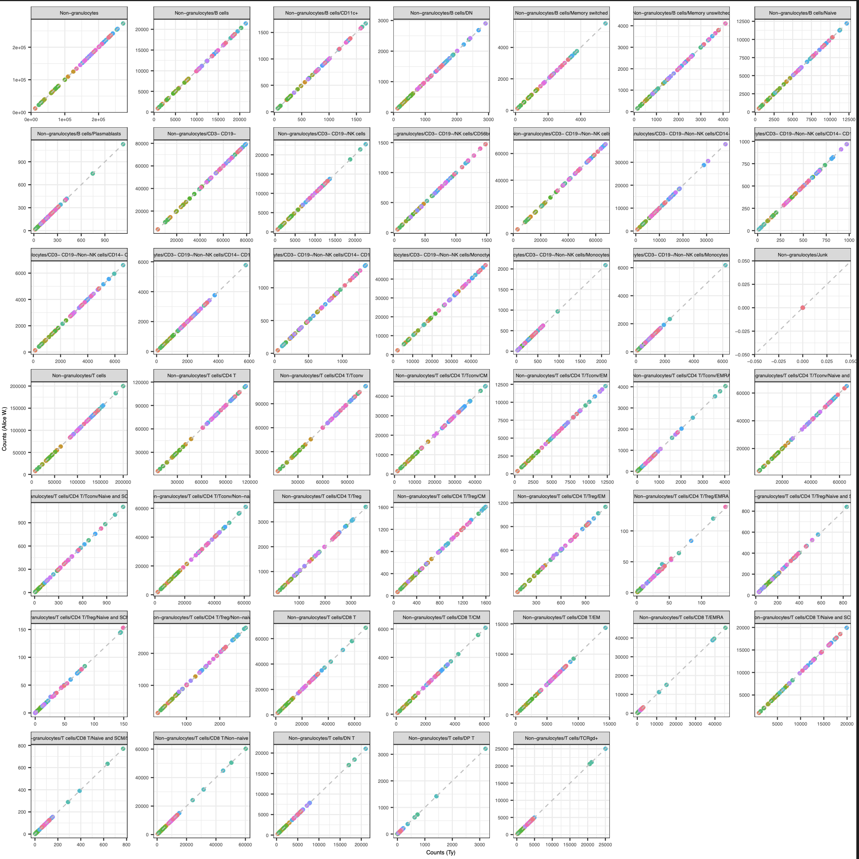
Next steps
IMPACD
created gating set in R, counts are ~expected values
will next look at gating at multiple, hierarchical levels
Test results in public datasets
Notes:
Alice W. working on single-param gates to send my way
Public data test is likely ~complicated by needing similar cohorts to see same effects
But public data test would be very important given concerns of overfitting… for the module analysis

Slide 16

Acknowledgements
Holly Akilesh
Long lab/HIPcore
Alice Long, Alice Wiedeman
Buckner lab
Jane Buckner, Sylvia Posso
Peter Linsley
Hannah DeBerg
Clinical team

Slide 17
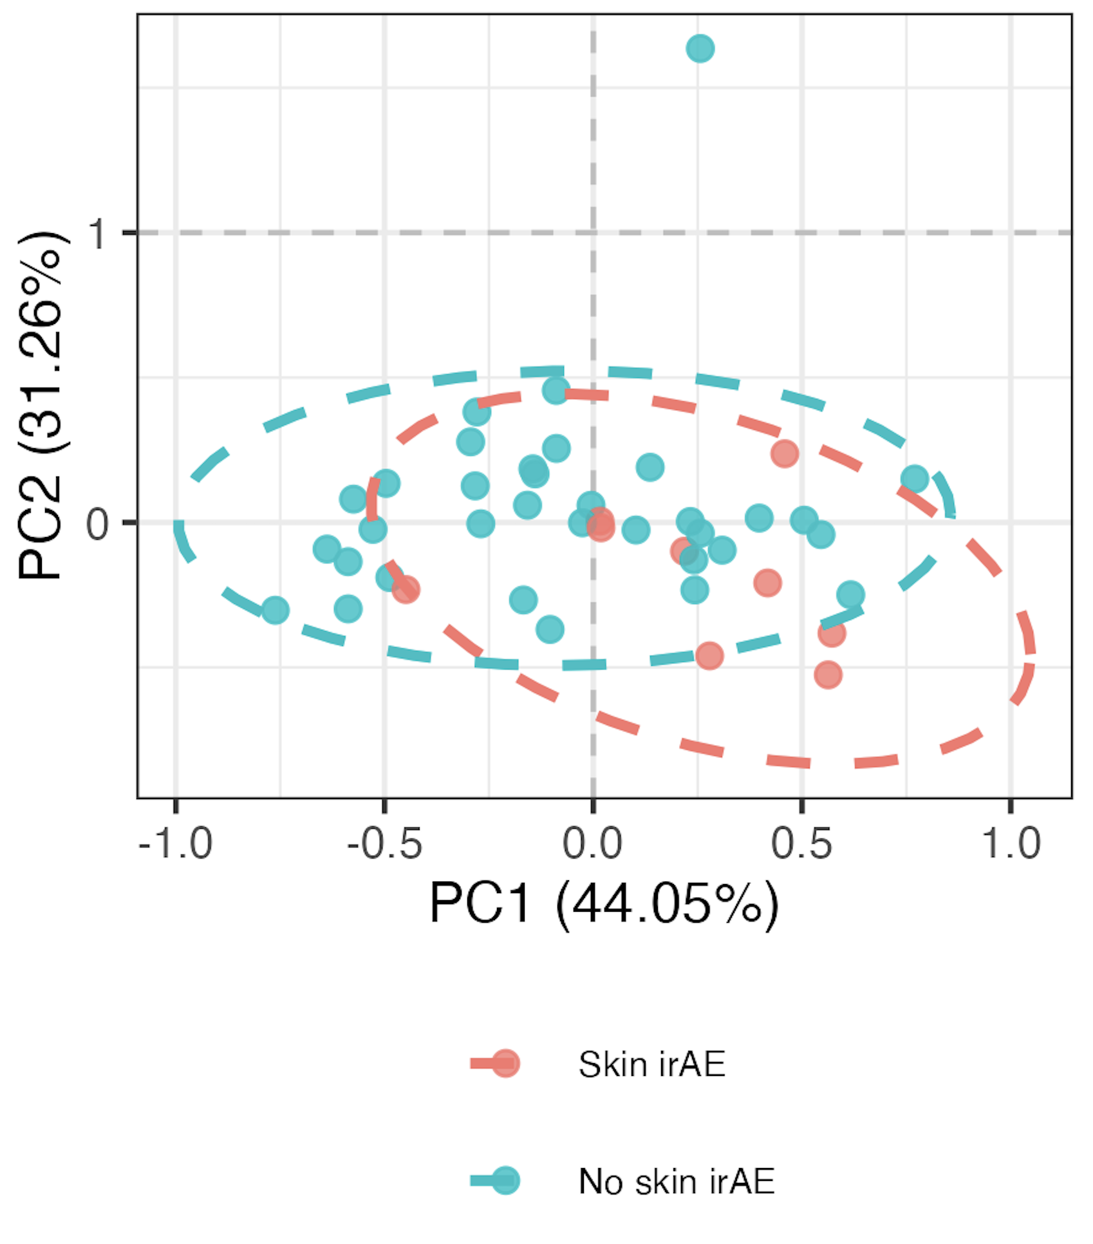
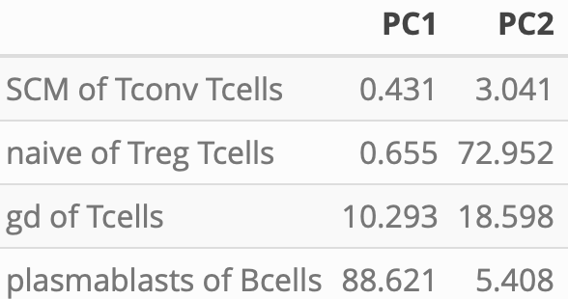
Distinguishing skin irAE group using module of top 4 skin irAE baseline features
PC1-2 contributions
PC1 *
PC2 *
**: p < 0.01, *: p < 0.05

Slide 18
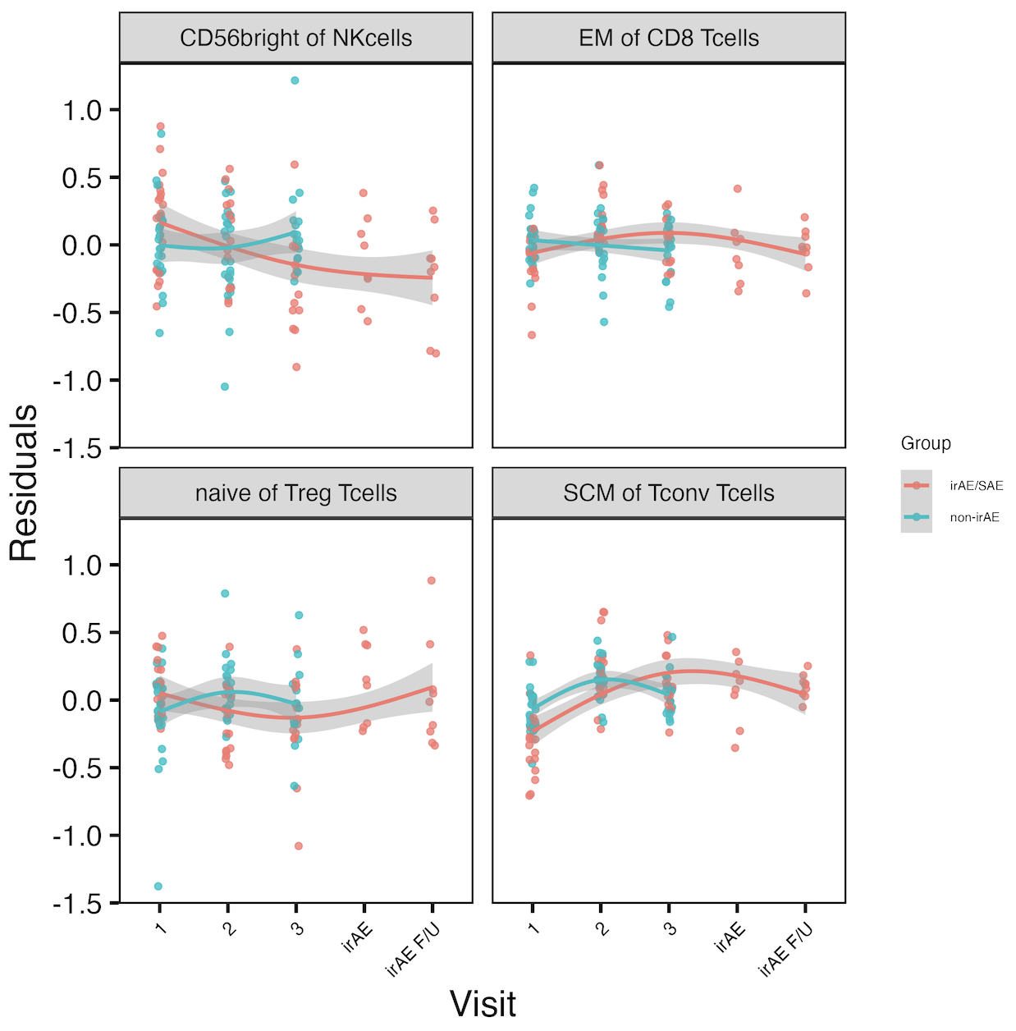
Other longitudinal combined irAE results
*
*
*
*
*
*: padj < 0.05
Notes:
See same trend in skin irAE group for CD56bright of NK, and this matches finding from Kovacsovics-Bankowski et al. J Immunother Cancer. 2024 (lower CD56bright of NK in patients at irAE max), surprisingly despite their cohort was mostly not pulmonary irAE and was mostly melanoma!

Slide 19
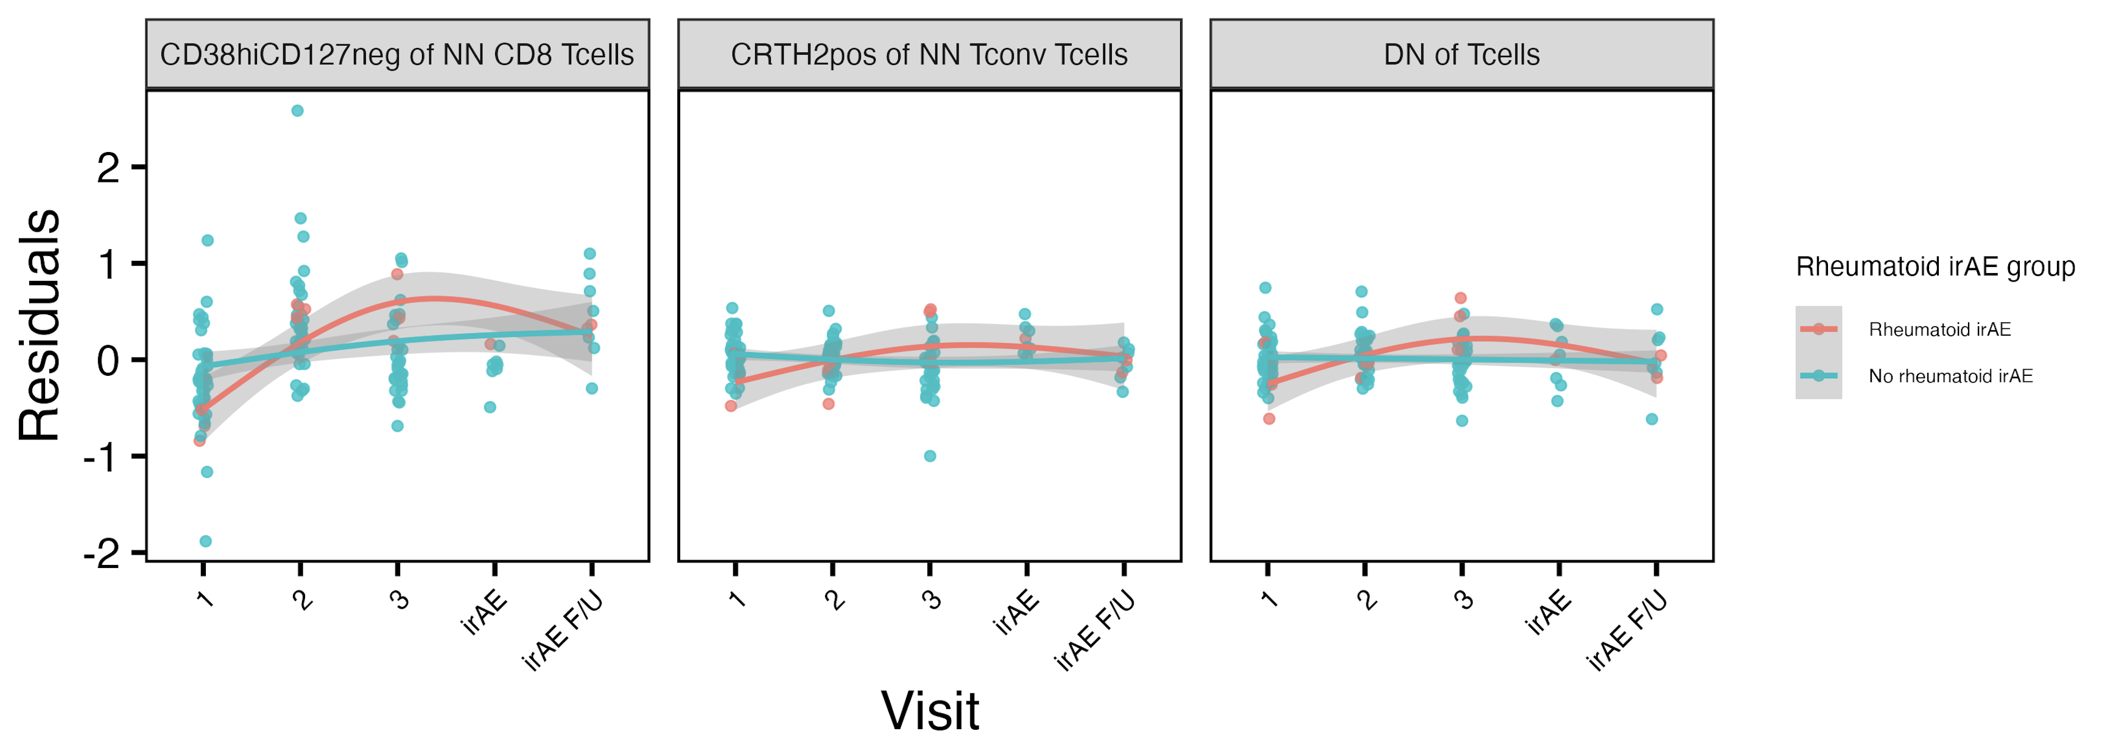
Other longitudinal “rheumatoid” irAE results
*
*
reported enriched in ICI-arthritis joints (Wang et al. Sci Immunol., 2023)
*: padj < 0.05
Notes:
# for rheumatoid, interaction (group-visit3) effects for DN of Tcells (padj = 0.044) and CRTH2+ of NN Tconv Tcells (padj = 0.015)

Slide 20
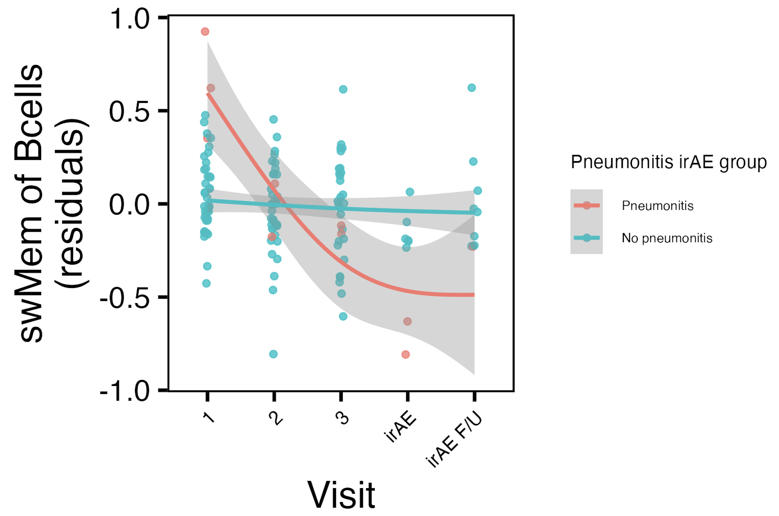
swMem of Bcells frequency decreases with ICI in pneumonitis irAE group
*
*: padj < 0.05

Slide 21
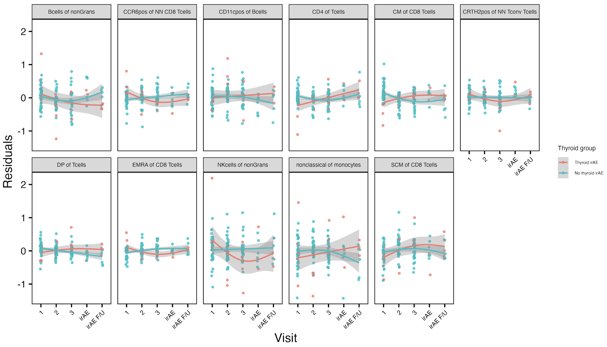
Several features’ frequencies change in thyroid irAE group-specific manner over visits
*
*
*
*
*
*
*
*
*
*
*
*
*
*
*
*: padj < 0.05

